Slide 1
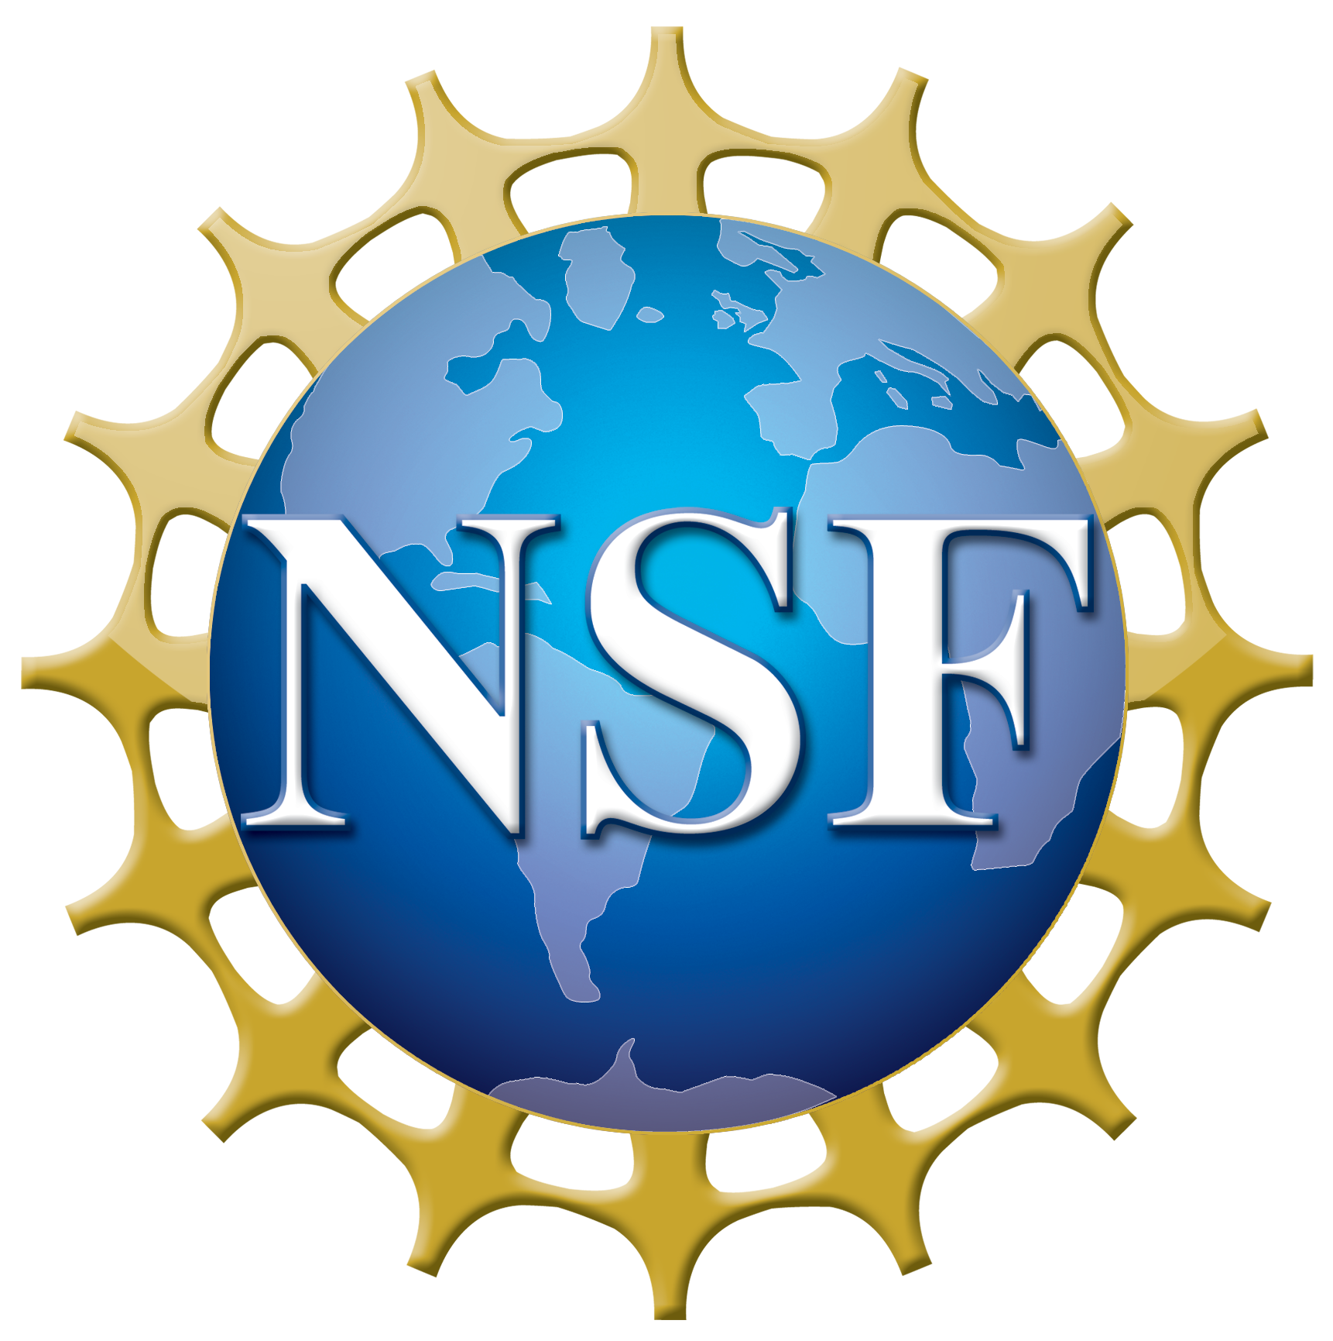
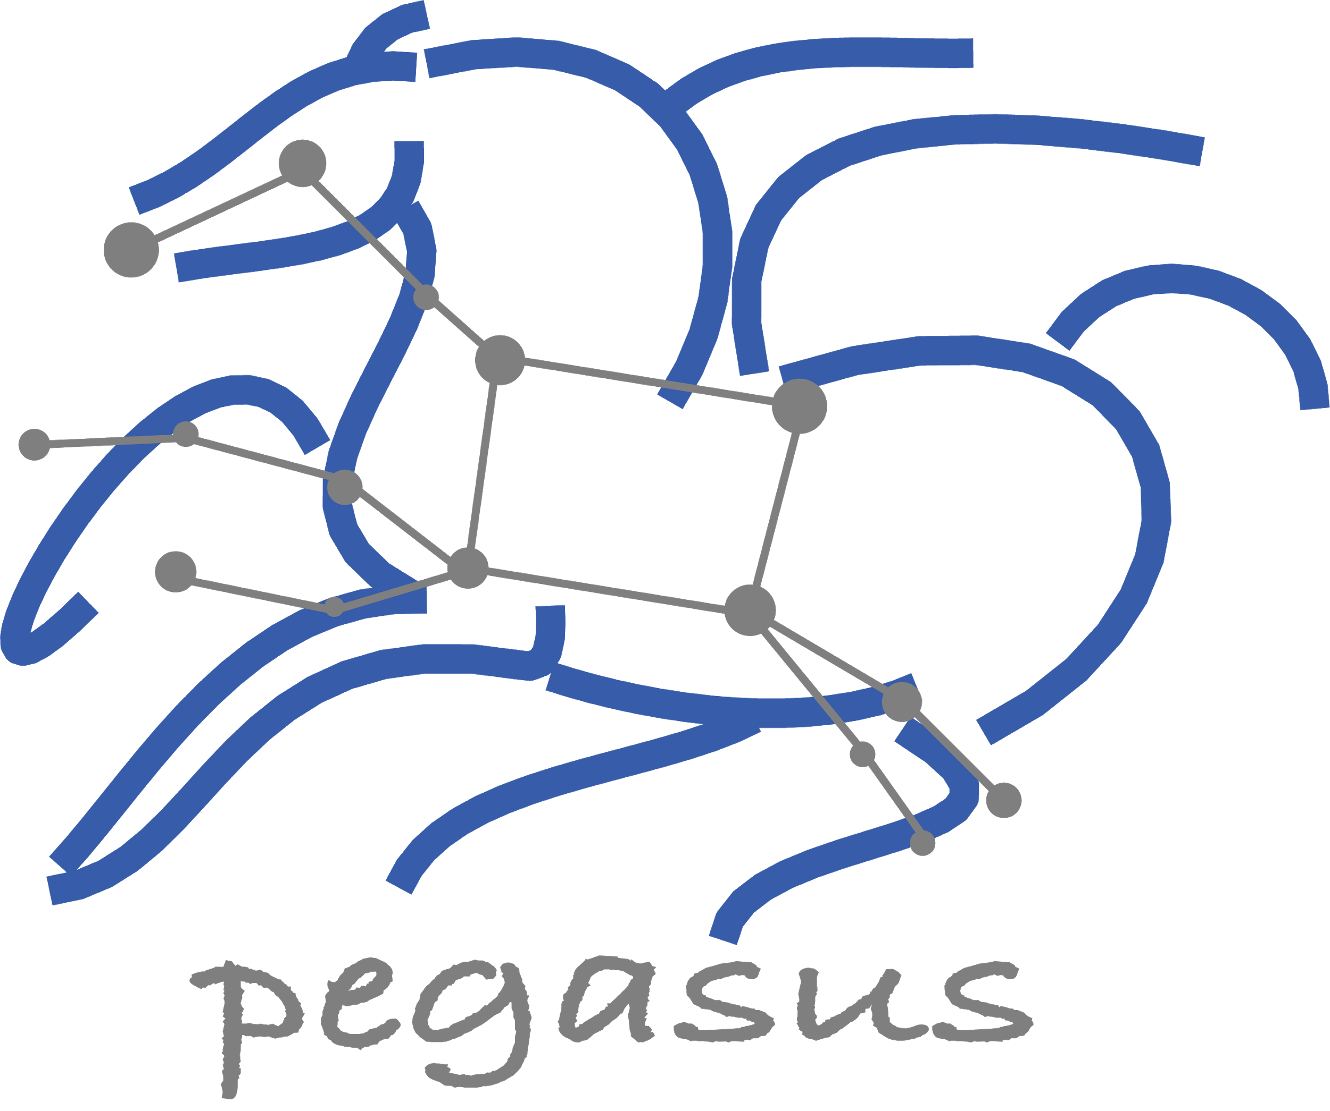
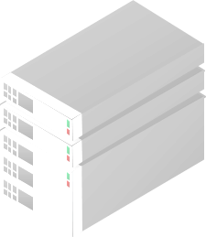
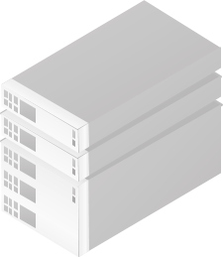
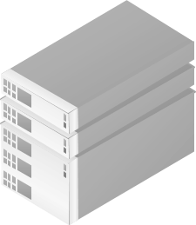
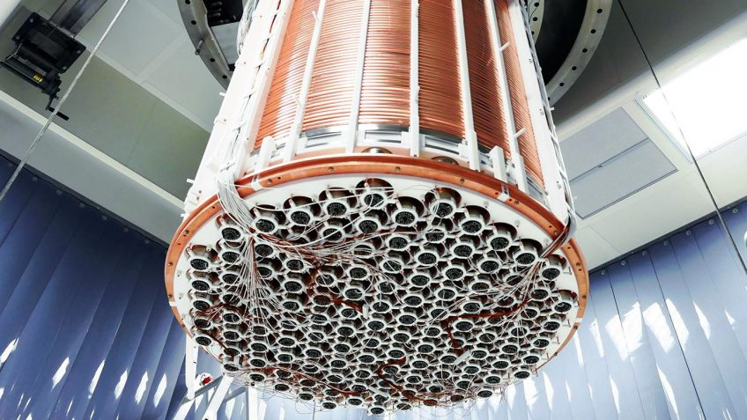
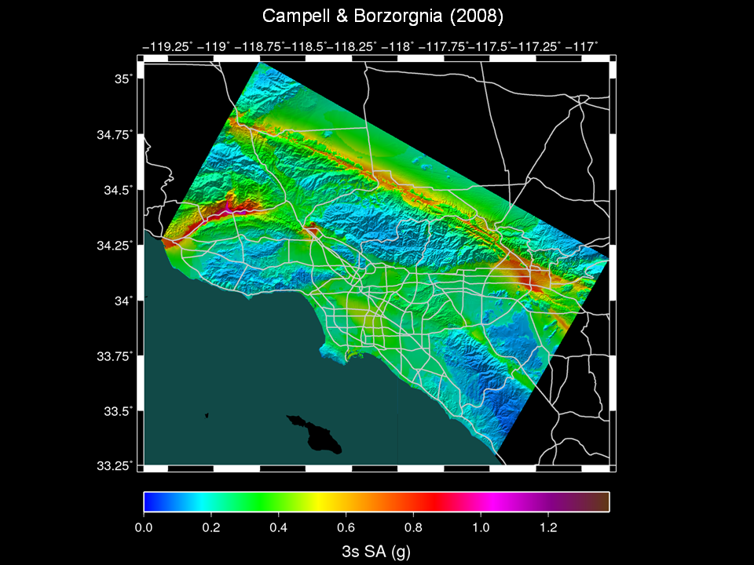
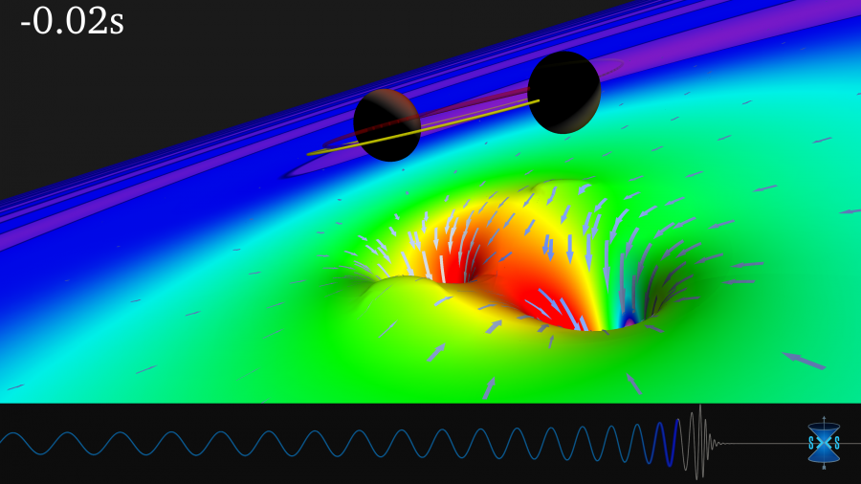
Pegasus Workflow Management System
Pegasus
WMS
End to End Workflow
Management
& Execution
Develop portable scientific workflows in Python, Java, and R
Compile workflows to be run on heterogeneous resources
Monitor and debug workflow execution via CLI and web-based tools
Recover from failures with built-in fault tolerance mechanisms
Regular release schedule incorporating latest research and development
Planner
Monitoring & Provenance
Engine
Scheduler
Job
Queue
jN
> Cloud Resources
> Open Science Grid
> HPC Systems
> HTCondor Pools
j2
j1
The XENONnT detector
Submit Node
Compute Resources
Laser Interferometer Gravitational Wave Observatory (LIGO) develops large scale analysis pipelines used for gravitational wave detection.
Southern California Earthquake Center (SCEC) CyberShake project generates hazard maps using hierarchical workflows .
The XENONnT project uses Pegasus for processing and monte carlo workflows, searching for dark matter
LIGO observation
of colliding black holes
Pegasus
in practice
Hazard map indicating maximum amount of shaking at a particular geographic location generated from SCEC’s CyberShake Pegasus workflow

